Slide 1
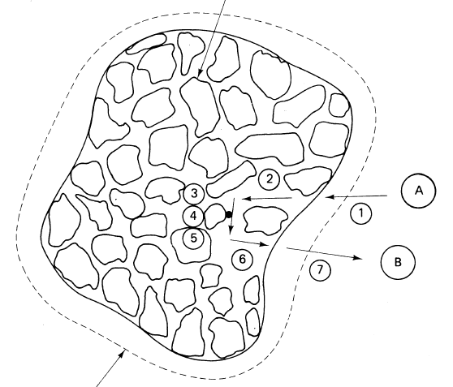
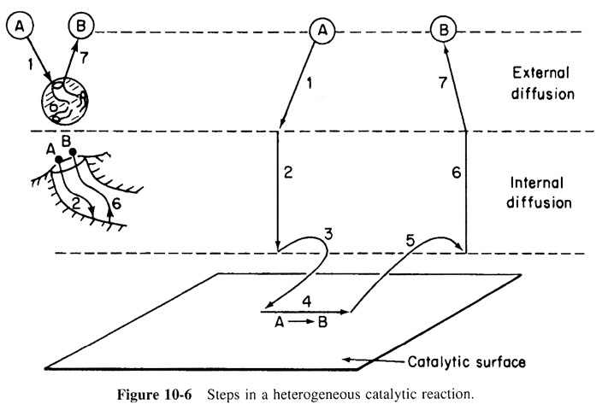
Review: Heterogeneous Catalyst
We have looked at cases where
  Adsorption, surface reaction, or desorption is rate limiting
  External diffusion is rate limiting
  Internal diffusion is rate limiting- today
Next time: Derive an overall rate law for heterogeneous catalyst where the rate limiting step as any of the 7 reaction steps. This new overall reaction rate would be inserted into the design equation to get W, X_{A}, C_{A}, etc

Slide 2
Review: Types of Boundary Conditions
Concentration at the boundary (i.e., catalyst particle surface) is specified:
  If a specific reactant concentration is maintained or measured at the surface, use the specified concentration
  When an instantaneous reaction occurs at the boundary, then C_{As}≈0
Flux at the boundary (i.e., catalyst particle surface) is specified:
  No mass transfer at surface (nonreacting surface)
  Reaction that occurs at the surface is at steady state: set the molar flux on the surface equal to the rate of reaction at the surface
  Convective transport across the boundary layer occurs
reaction rate per unit surface area (mol/m²·sec)
Planes of symmetry: concentration profile is symmetric about a plane
  Concentration gradient is zero at the plane of symmetry
Radial diffusion in a tube:
Radial diffusion in a sphere
r
r

Slide 3
Review: Transport & Rxn Limited Rates
reaction limited regime:
Used k_{c}(C_{Ab}-C_{As})=k_{r}C_{AS} to solve for C_{As} & plugged back into –r”_{As}= k_{r}C_{AS}
  transport limited regime
  (Convective transport across boundary layer)
-r_{A}’
(U/d_{p})^{1/2}
(fluid velocity/particle diameter)^{1/2}
When measuring rates in the lab, use high velocities or small particles to ensure the reaction is not mass transfer limited

Slide 4
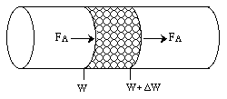
Review: Mass Transfer Limited Rxn in PBR
A steady state mole balance on reactant A between z and z + Δz :
a_{c}: external surface area of catalyst per volume of catalytic bed (m²/m³)
φ: porosity of bed, void fraction d_{p}: particle diameter (m)
r’’_{A}: rate of generation of A per unit catalytic surface area (mol/s·m²)
A_{c}: cross-sectional area of tube containing catalyst (m²)
Divide out A_{c}Δz and take limit as Δz→0
Put F_{az} and –r_{A}’’ in terms of C_{A}
Assume that axial diffusion is negligible compared to bulk flow
Assume molar flux of A to surface = rate of consumption of A at surface
Rearrange, integrate, and solve for C_{A} and r’’_{A}

Slide 5
Shrinking Core Model
Solid particles are being consumed either by dissolution or reaction
  The amount of the material being consumed is shrinking
  Drug delivery (pill in stomach)
  Catalyst regeneration
Regeneration of catalyst by burning off carbon coke in the presence of O₂
Begins at the surface and proceeds to the core
Because the amount of carbon that is consumed (burnt off) is proportional to the surface area, and the amount of carbon that is consumed decreases with time

Slide 6
Catalyst Regeneration
Coking-deactivated catalyst particles are reactivated by burning off the carbon
R₀
Oxygen (A) diffuses from particle surface (r = R₀, C_{A} = C_{A0}) through the porous pellet matrix to the unreacted core (r = R, C_{A} = 0)
Reaction of O₂ with carbon at the surface of the unreacted core is very fast
CO₂ generated at surface of core diffuses out
Rate of oxygen diffusion from the surface of the pellet to the core controls rate of carbon removal
O₂
r+Δr
r
R
CO₂
r : radius R₀:outer radius of particle R: radius of unreacted core r = 0 at core
What is the rate of time required for the core to shrink to a radius R?
Though the core of carbon (from r = 0 to r = R₀) is shrinking with time (unsteady state), we will assume the concentration profile at any time is the steady state profile over distance (R₀- R): quasi-steady state assumption (QSSA)

Slide 7
Mole Balance on O₂ From r to r+Δr
R₀
Rate in - rate out + gen = accum
O₂
r+Δr
Oxygen reacts at the surface, not in this region
r
R
Divide by -4πΔr:
CO₂
Take limit as Δr→0:
Put W_{Ar} in terms of conc of oxygen (C_{A})
D_{e}: effective diffusivity
For every mole of O₂ that enters, a mol of CO₂ leaves → W_{O2}=-W_{CO2}
Plug W_{Ar} into mole balance:
Divide out –D_{e}:

Slide 8
Mole Balance on O₂ From r to r+Δr (2)
R₀
O₂
r+Δr
r
Use boundary conditions to determine the concentration profile (C_{A}/C_{A0}) in terms of the various radii (R, R₀ & r)
R
At r = R₀, C_{A}= C_{A0} and at r = R, C_{A}= 0
First use C_{A}=0 when r = R to determine K₂
CO₂
Next solve for when r = R₀ & C_{A}=C_{A0}
For any r:
Take the ratio to determine C_{A}/C_{A0}

Slide 9
Oxygen Concentration Profile & Flux
C_{A}: oxygen concentration
C_{Ab} = C_{A0}
R₀
O₂
r+Δr
Oxygen concentration Profile at time t
r
R
CO₂
Finally determine the flux of oxygen to the surface of the core:
R
(center)
(core)
R₀

Slide 10
Mass Balance on Carbon (C)
R₀
In – out + gen = accumulation
O₂
r+Δr
r
Elemental C does not enter or leave the surface
R
Change in the mass of the carbon core
CO₂
r’’_{C}: rate of C gen. per unit surface area of core (mol/s·m²)
ρ_{C}: density of solid C φ_{C}: fraction of the volume of the core that is C
Simplify mass balance:
The rate of carbon disappearance (-dR/dt) is equal to the rate of oxygen flux to the surface of the core, -W_{O2} = W_{CO2}, and this occurs at a radius of R so:

Slide 11
Time Required to Shrink Core to Radius R
R₀
O₂
r+Δr
Substitute r’’_{c} into -dR/dt, get like terms together, integrate, & solve for t
r
R
Integrate over 0 to t & R₀ to R
CO₂
Get common denominators

Slide 12
Time Required to Shrink Core to Radius R
R₀
O₂
Solve for t:
r+Δr
r
Factor out R₀²/6
R
Factor out -1
CO₂
At the core of the catalyst particle, R=0, then:
Complete regeneration

Slide 13
L20: Internal Diffusion Effects in Spherical Catalyst Particles
Internal diffusion: diffusion of the reactants or products from the external pellet surface (pore mouth) to the interior of the pellet. (Chapter 12)
When the reactants diffuse into the pores within the catalyst pellet, the concentration at the pore mouth will be higher than that inside the pore and the entire catalytic surface is not accessible to the same concentration.
Though A is diffusing inwards, convention of shell balance is flux is in direction of increasing r. (flux is positive in direction of increasing r). In actuality, flux of A will have a negative sign since it moves inwards.
C_{As}
Porous catalyst particle
C_{Ab}
C_{A}(r)
External diffusion
Internal diffusion
External surface

Slide 14

Basic Molar Balance for Differential Element
C_{As}
An irreversible rxn A→B occurs on the surface of pore walls within a spherical pellet of radius R:
R
r
Rate of A in at r = W_{Ar} · area =
r+Δr
Rate of A out at r - Δr = W_{Ar} · area =
The mole balance over the shell thickness Δr is:
Spherical shell of inner radius r & outer radius r+Δr
IN - OUT + GEN =ACCUM
Volume of shell
r’_{A}: rate of reaction per mass of catalyst (mol/g•s)
ρ_{c}: mass of catalyst per unit volume of catalyst (catalyst density)
r_{m}: mean radius between r and r - Δr
Divide by -4πΔr & take limit as Δr →0
Differential BMB in spherical catalyst particle

Slide 15
Diffusion Equation (Step 2)
C_{As}
IN - OUT + GEN =ACCUM
R
Steady state assumption implies equimolar counter diffusion, W_{B} = -W_{A} (otherwise A or B would accumulate)
r
r+Δr
Must use effective diffusivity, D_{e}, instead of D_{AB} to account for:
Tortuosity of paths
Void spaces
Pores having varying cross-sectional areas
bulk diffusivify
pellet porosity (V_{void space}/V_{void & solid}) (typical ~ 0.4)
constriction factor (typical ~ 0.8)
tortuosity (distance molecule travels between 2 pts/actual distance between those 2 pts) (typical ~ 3.0)

Slide 16
Diffusion & Rxn in a Spherical Catalyst
C_{As}
R
r
Write the rate law based on surface area:
Relate r’_{A} to r’’_{A} by:
Insert the diffusion eq & the rate eq into the BMB:
Boundary Conditions:
C_{A} finite at r=0 C_{A} = C_{As} at r =R
Solve to get C_{A}(r) and use the diffusion equation to get W_{Ar}(r)

Slide 17
Dimensionless Variables
Put into dimensionless form
Boundary Conditions:
Ψ =1 at λ=1 Ψ =finite at λ=0
Thiele modulus for rxn of n^{th} order ≡ φ_{n}
Subscript n = reaction order
φ_{n} is small: surface reaction is rate limiting
φ_{n} is large: internal diffusion is rate limiting
small φ₁
The solution for a 1st order rxn:
medium φ₁
large φ₁
small φ₁: surface rxn control, significant amount of reactant diffuses into pellet interior w/out reacting
R
r=0
large φ₁: surface rxn is rapid, reactant is consumed very closed to the external surface of pellet (A waste of precious metal inside of pellet)

Slide 18
Internal Effectiveness Factor, η
Internal effectiveness factor:
(1) the relative importance of diffusion and reaction limitations
(2) a measurement of how far the reactant diffuses into the pellet before reacting
For example, when n=1 (1st order kinetics, -r’’_{As} )

Slide 19
Internal Diffusion & Overall Rxn Rate
η quantifies how internal diffusion affects the overall rxn rate
Effectiveness factor vs φ_{n}
1
0.8
Reaction limited
0.6
η
0.4
0.2
Internal diffusion limited
0.1
0.2
1
2
4
6
8
10
φ₁
As particle diameter ↓, φ_{n} ↓, η→1, rxn is surface rxn limited
As particle diameter ↑, φ_{n} ↑, η→0, rxn is diffusion limited
This analysis was for spherical particles. A similar approach can be used to evaluate other geometries, non-isothermal rxn, & more complex rxn kinetics

Slide 20
Effectiveness Factor & Rxn Rate
surface-reaction-limited
φ₁ is large, diffusion-limited reaction inside the pellet (external diffusion will have a negligible effect on the overall rxn rate because internal diffusion limits the rxn rate)
internal-diffusion-limited:
Overall rate for 1st-order rxn

Slide 21
Clicker Question
Overall rate for 1st-order rxn
When the overall rate of rxn when the reaction is limited by internal diffusion, which of the following would decrease the internal diffusion limitation?
decreasing the radius R of the particle
increasing the concentration of the reactant
increasing the temperature
(d) increasing the internal surface area
(e) Both a and b

Slide 22
Total Rate of Consumption of A in Pellet, M_{A} (mol/s)
At steady state, net flow of A into pellet at the external surface completely reacts within the pellet
Overall molar rxn rate = total molar flow of A into catalyst pellet
M_{A} = (external surface area of pellet) x (molar flux of A into pellet at external surface)
M_{A} =the net rate of reaction on and within the catalyst pellet

